Slide 1
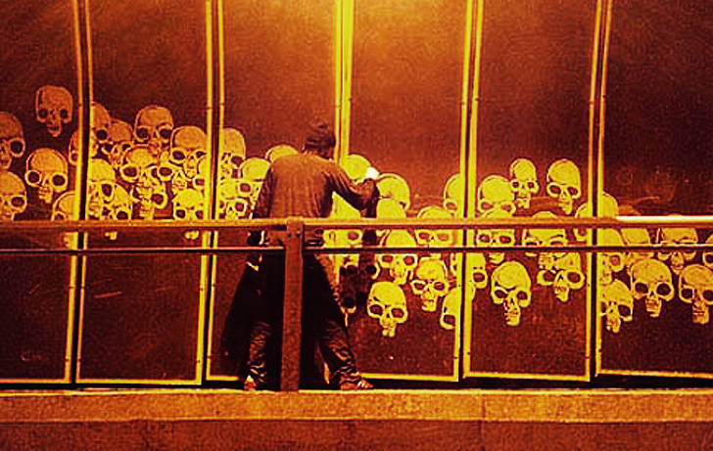
Reverse Graffiti page 48

Slide 2

Reverse Graffiti
Read the following sentences. Do you agree with any of them?
Art should be pleasing to the viewer.
Art should involve effort on the part of the artist.
Art should involve technical skill.
Art should have a social message or make a political point.

Slide 3
Listen again
What are the roles of an artist and a viewer according to the speaker?

Slide 4
Reverse Graffiti
When is cleaning walls a crime? When you’re doing it to create art, obviously. A number of street artists around the world have started expressing themselves through a practice known as reverse graffiti. Inspired by the ‘clean me’ messages that you see written on the back of some trucks, they find dirty surfaces and inscribe them with images or messages using cleaning brushes or pressure hoses. Either way, it’s the same principle: the image is made by cleaning away the dirt.
What is reverse graffiti?
What inspired reverse graffiti?
What tools are used by graffiti artists?
How is the image made?

Slide 5
Each artist has their own individual style but all artists share a common aim: to draw attention to the pollution in our cities. The UK’s Paul Curtis, better known as Moose, operates around Leeds and London and has been commissioned by a number of companies to make reverse graffiti advertisements.
What common aim combines graffiti artists?
Do artist have the same style?
Name an important graffiti artist.
Why was Moose commissioned by some countries?

Slide 6
Brazilian artist, Alexandre Orion, turned one of São Paulo’s transport tunnels into an amazing mural in 2006 by scraping away the dirt. Made up of a series of white skulls, the mural reminds drivers of the effect their pollution is having on the planet. ‘Every motorist sits in the comfort of their car, but they don’t give any consideration to the price their comfort has for the environment and consequently for themselves,’ says Orion.
Where does Orion come from?
What was Orion’s most impressive achievement?
How was this mural made?
What is the aim behind this mural?
What is Orion’s criticism of motorists?

Slide 7
The anti-pollution message of the reverse graffiti artists confuses city authorities since the main argument against graffiti is that it spoils the appearance of both types of property: public and private. This was what Leeds City Council said about Moose’s work: ‘Leeds residents want to live in clean and attractive neighbourhoods.
What message does reverse graffiti artists try to show?
Why is this message confusing for authorities?
What properties are more likely to be spoiled by graffiti?
What is Leeds City Council’s argument against Moose’s work?

Slide 8
We view this kind of advertising as environmental damage and will take strong action against any advertisers carrying out such campaigns.’ It seems that no action was taken against the advertisers – no fines nor any other punishment – but Moose himself was ordered to ‘clean up his act’. How was he supposed to do this: by making all property he had cleaned dirty again?
Why does the counsel reject this kind of advertising?
How will the government react against this kind of advertising?
Were these advertisers punished?
What was Moose asked to do?

Slide 9
As for the Brazilian artist’s work, the authorities were annoyed but could find nothing to charge him with. They had no other option but to clean the tunnel – but only the parts Alexandre had already cleaned. The artist merely continued his campaign on the other side. The city officials then decided to take drastic action. They not only cleaned the whole tunnel but also every tunnel in São Paulo.
Was the Brazilian artist’s punished? Why not?
What did the government do?
Did the artist stop?
What did the government have to do concerning the tunnels?

Slide 10
Critical Thinking
What do you think about Graffiti in cities? Do you think it improves or spoils the appearance of the urban landscape?

Slide 11
Assignment 1
Use the information in the article to complete these sentences. Use one word per space.
1. Reverse graffiti works by cleaning away the _________ on walls.
2. The aim of the reverse graffiti artists is to highlight the problem of ____.
3. Some reverse graffiti artists are paid to make images that act as __________.
4. Orion made his message for ________.
5. The local authorities in Leeds were ________ by this new type of graffiti.
6. In Sao Paulo, the response of the authorities was to __________ every tunnel.

Slide 12
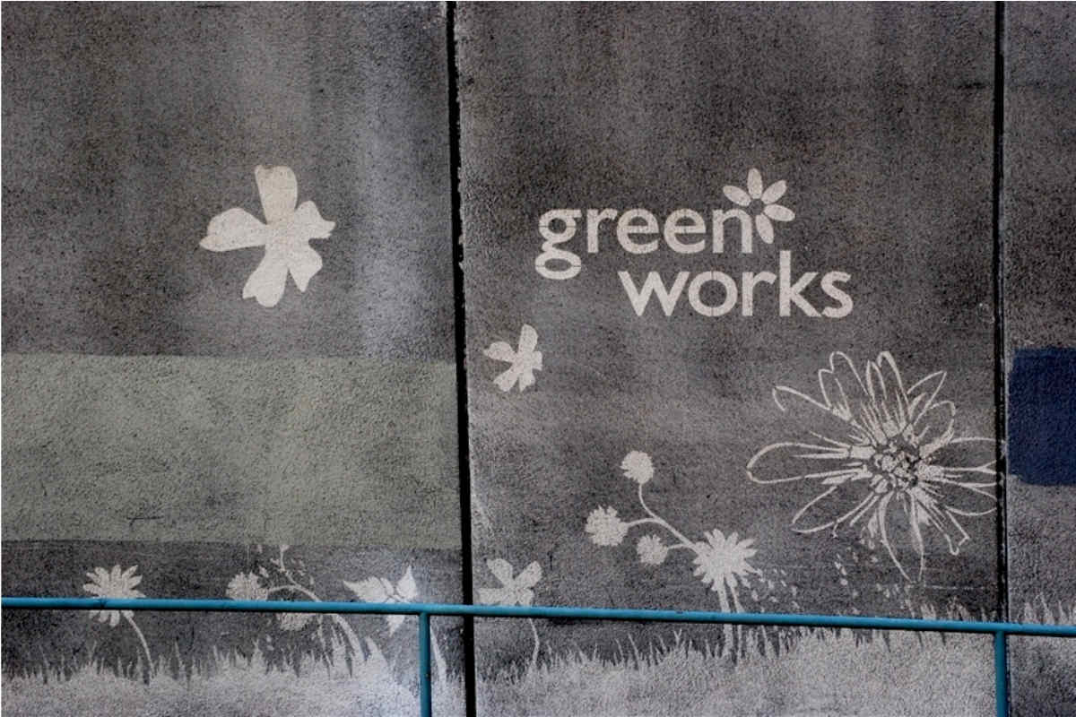
Comment

Slide 13
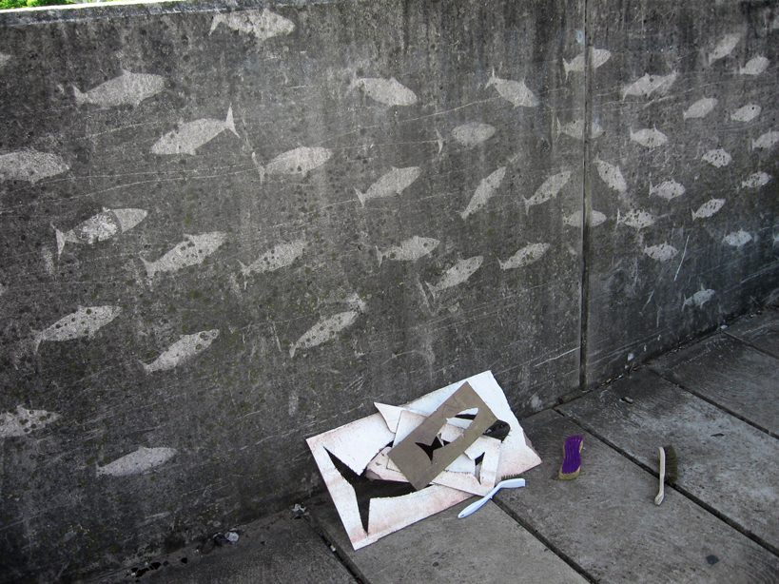

Slide 14
